Slide 1

Yelp Would Know What You Like
Group Member: Guoxiangchi He, Sijin Zhou, Yuying Shi

Slide 2
Content
1. Problem Overview
2. Exploratory Data Analysis
3. Classification. (1) Logistic regression (2) Decision tree (3) Random forest
4. Regression (1) Linear regression (2) Decision Tree
5. PySpark ALS
6. Conclusion

Slide 3
Problem Overview
Problem description
This is a recommendation system based on existed users and business information, giving potential business choices to users they never been before and would be interested in.
More specifically, we use Classification, Regression models which are based on business information and user information. And ALS model which focus only on review stars.

Slide 4
Problem Overview
Dataset description
Data source: https://www.yelp.com/dataset
Three json. data files:
User.json contains each user basic information like joining yelp time/name/fans/friends and personal evaluation giving to business like average stars/review counts. (1,968,703*22)
Business.json contains each business basic information like opening time/geographical location/categories and public evaluation they received like average stars/review counts. (1,968,703*19 )
Review.json contains each review text & star from one user to one specific business. (8,021,122*8)

Slide 5
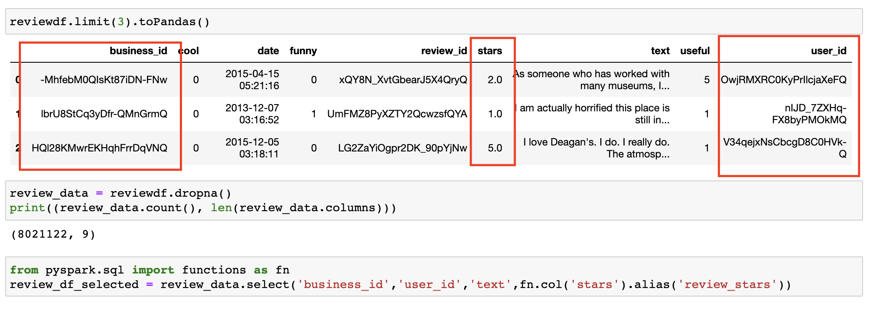
(1) Review.df columns selection
Exploratory Data Analysis

Slide 6
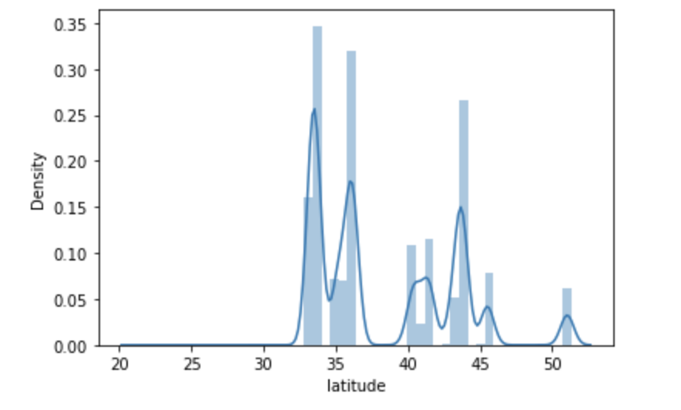
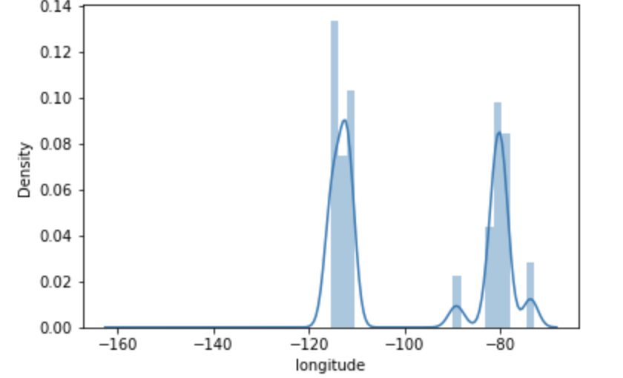
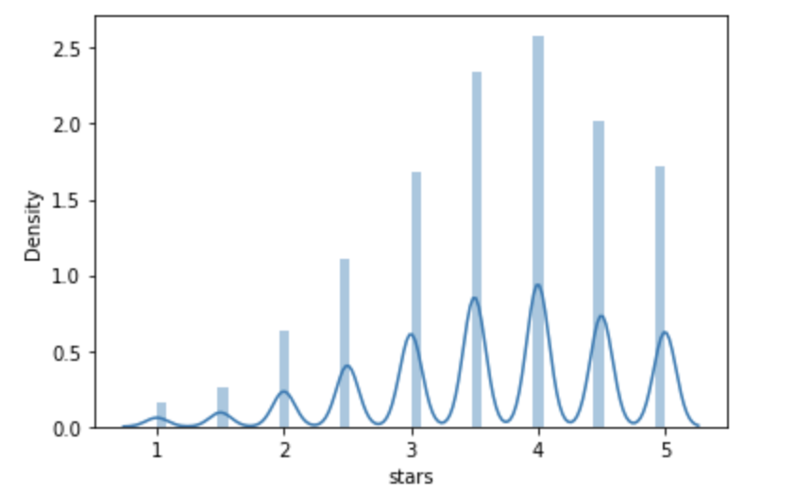
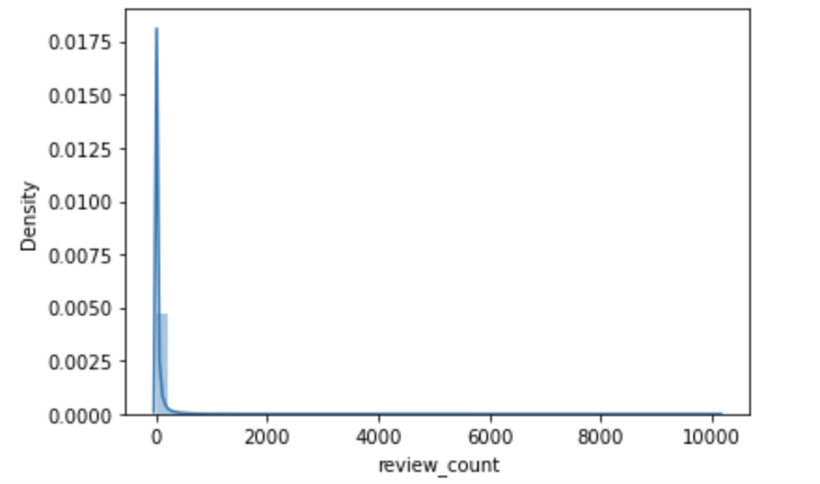
(2) Business.df columns selection
Exploratory Data Analysis
Numeric features visualization

Slide 7

Business.df Categories Wordcloud
Exploratory Data Analysis

Slide 8
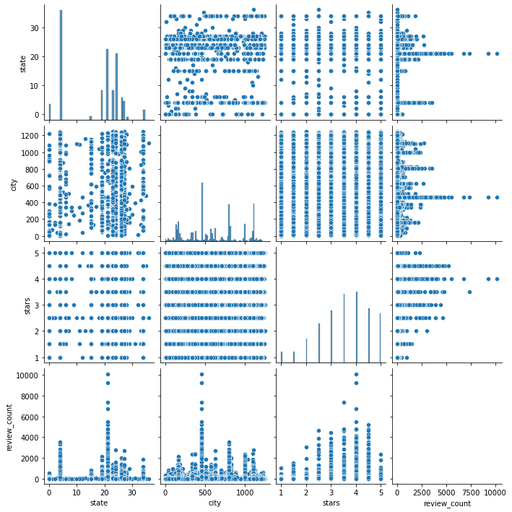
Business.df numeric variables scatter plot
Exploratory Data Analysis

Slide 9
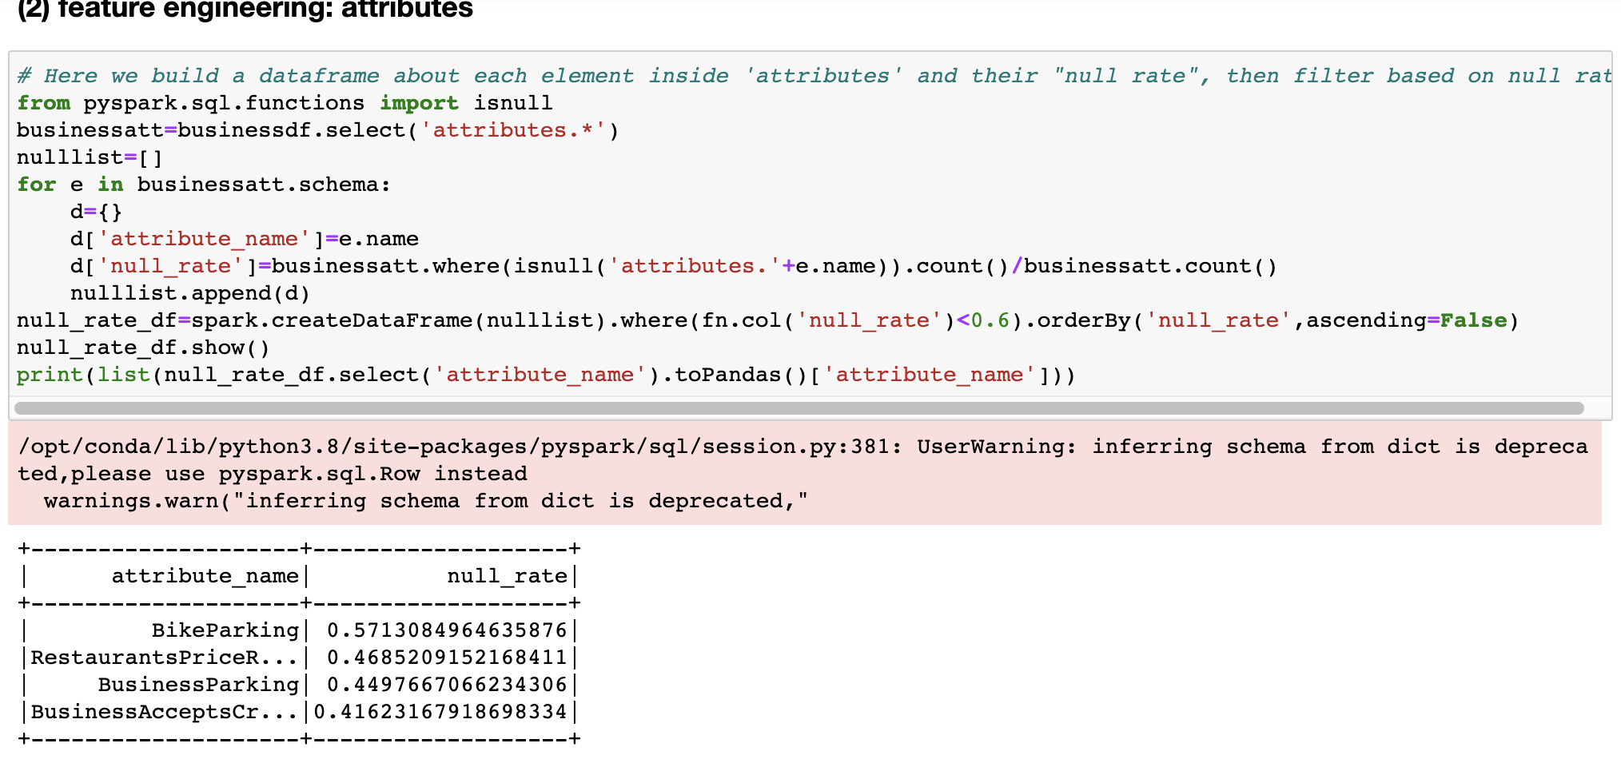
Business.df Attributes Selection
Exploratory Data Analysis
Filter: select attributes which Null ratio is lower than 60%.

Slide 10
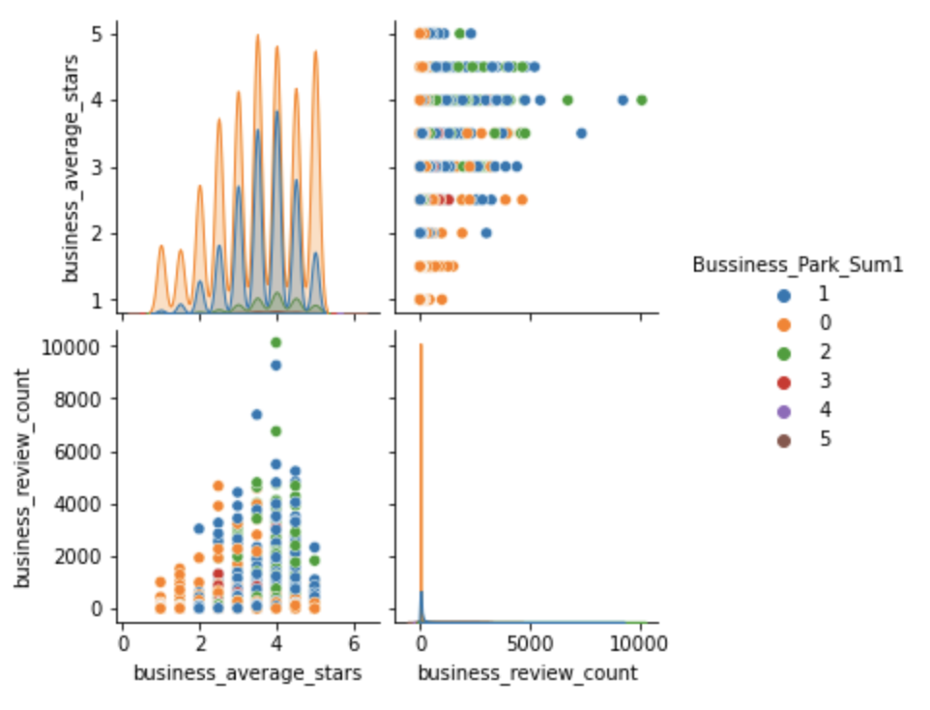
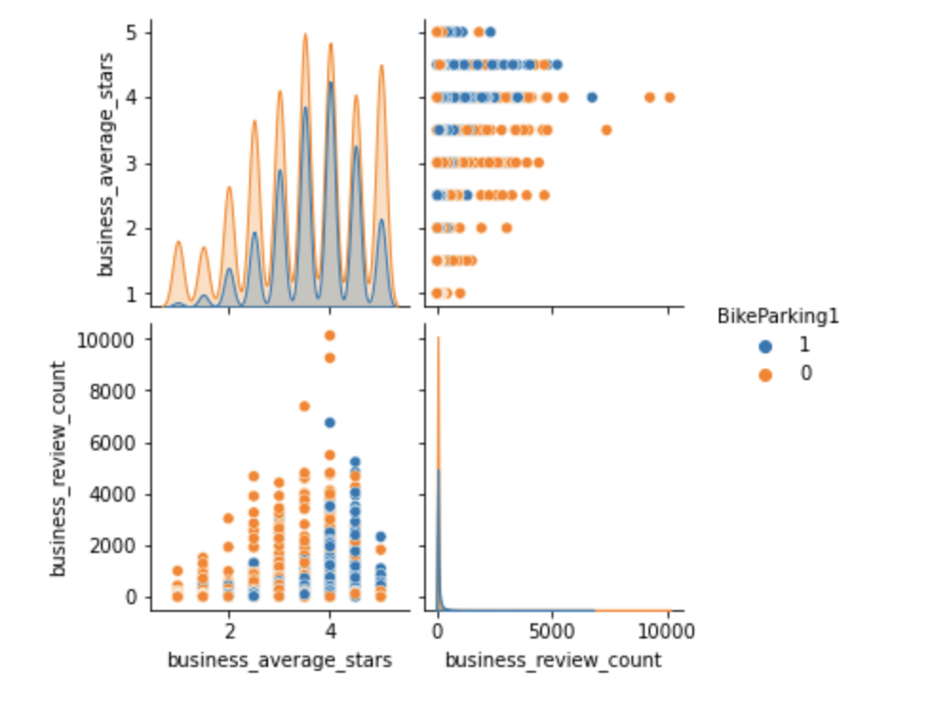
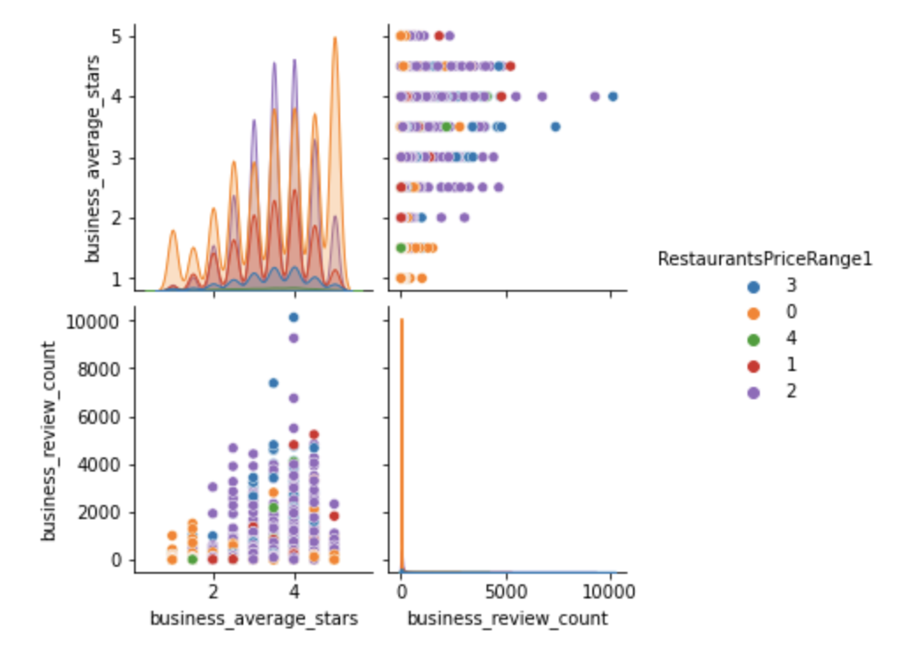
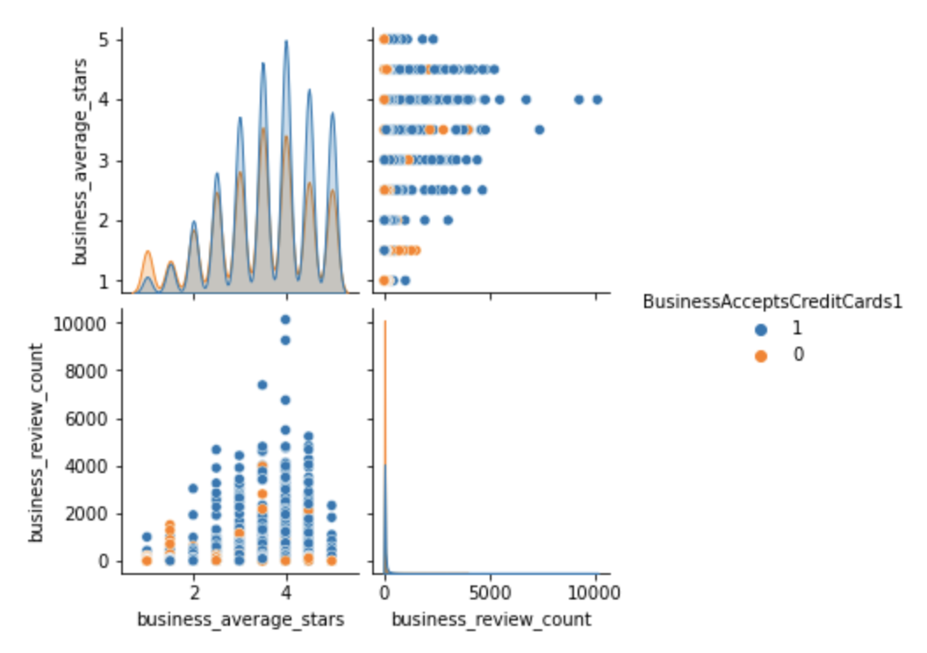
business.df numeric variables scatter plot + dummy
Exploratory Data Analysis

Slide 11
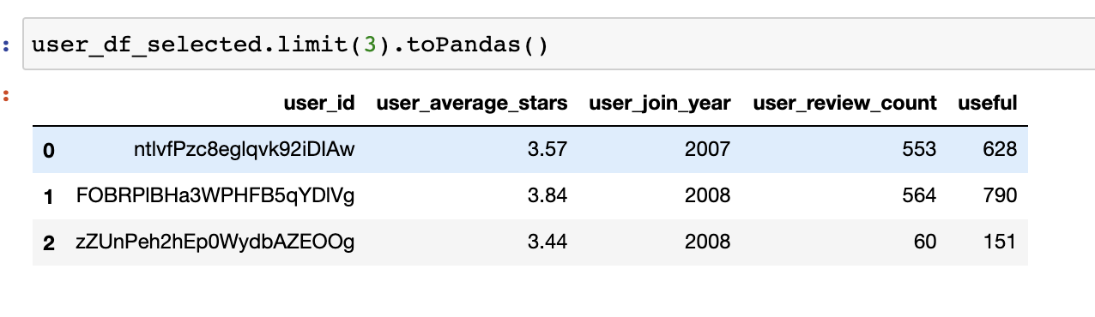
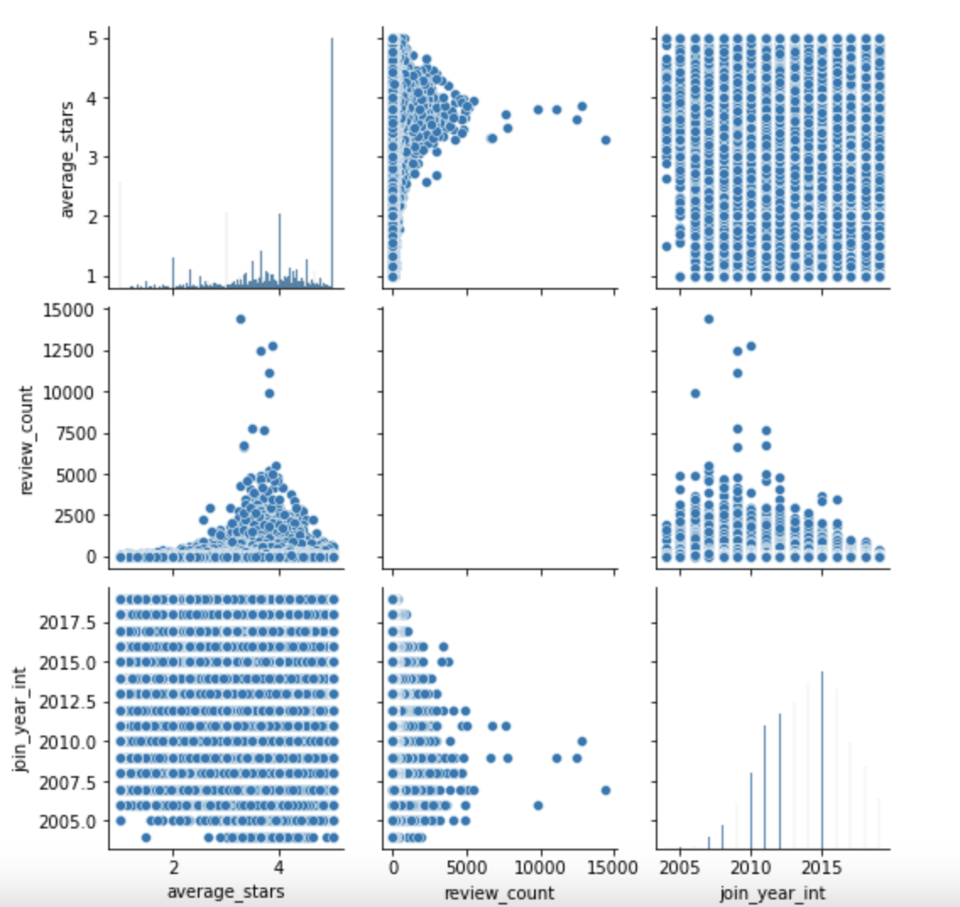
(3) User.df selection
Exploratory Data Analysis
convert join year from object to numeric

Slide 12
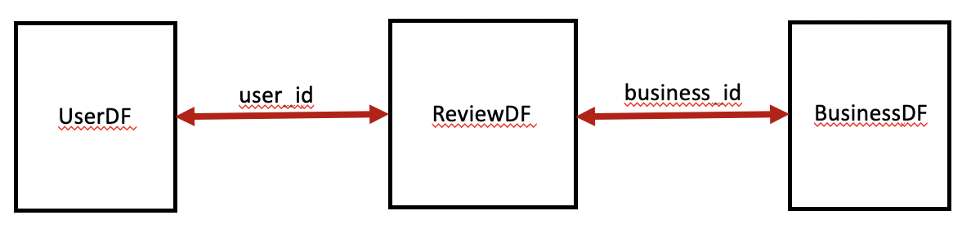
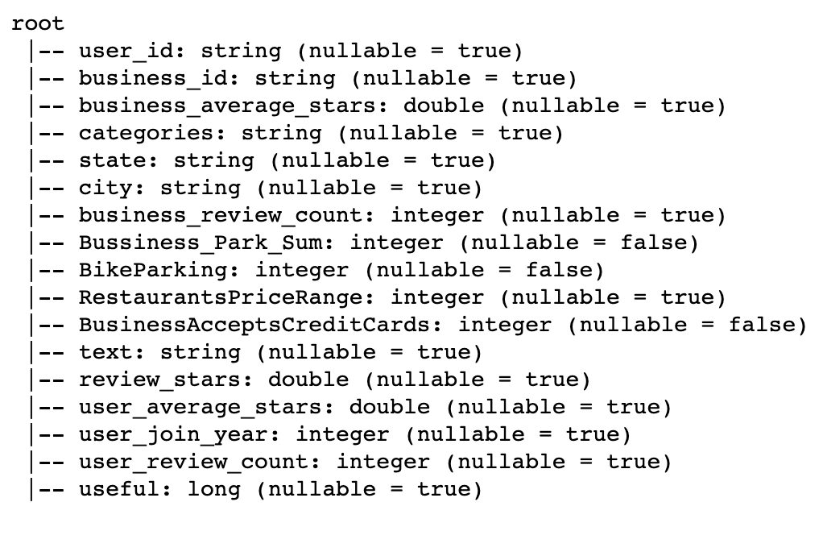
(4) Join three Dataframes
Exploratory Data Analysis
Filter:
• business_review_count<50
• user_review_count<50
• city = Las Vegas

Slide 13
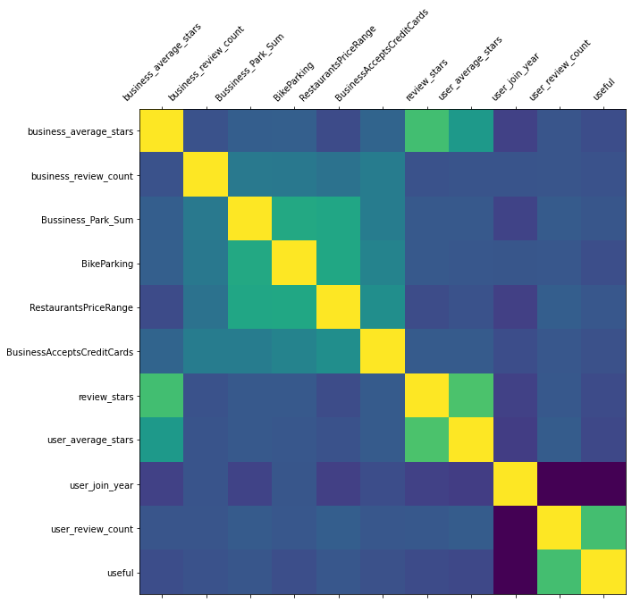
Correlation Matrix of Combined.df
Exploratory Data Analysis
Provide hints to feature engineering:
• business_average_stars &
user_average_stars are really useful
• other features are not that useful,
use PCA to transform to 3 most useful
features

Slide 14
Feature engineering
Feature Engineering
user_join_year → OneHotEncoder
2. business_review_count & user_review_count → MinMaxScaler
3. user_join_year, business_review_count, user_review_count,
Bussiness_Park_Sum, BikeParking, RestaurantsPriceRange,
BusinessAcceptsCreditCards → PCA, k=3
4. business_average_stars, user_average_stars, 3 PCA features
→ Final feature for model

Slide 15
Model Selection
Classification
(1) Classification
• Treat this as classification task, use basic information of user and business as feature, classify review_star to category 1,2,3,4,5.
• training: validation: testing=6:3:1
• model evaluator: MulticlassClassificationEvaluator
• evaluation method use AUC

Slide 16
Classification Steps
Classification
Feature Engineering
Logistic Regression
regParam | 0.01,0.05,0.1
elasticNetParam | 0.3,0.5,0.7
Decision Tree
maxDepth | 5,10,15,20,25,30
Random Forest
maxDepth | 5, 10
numTrees | 5, 10
Fit training df
Logistic Regression
regParam | 0.01
elasticNetParam | 0.7
Decision Tree
maxDepth | 10
Random Forest
maxDepth | 10
numTrees | 5
Transform validation df
AUC: 0.697558890228659
AUC: 0.6999904210135934
AUC: 0.698880653895671
Best Classification Model
Test with testing df
AUC: 0.7016107123210292
AUC: 0.7050435599751262
AUC: 0.7028924313870027

Slide 17
Model Selection
Regression
(2) Regression
• Treat this as regression task, use basic information of user and business as feature, predict numerical review_star.
• training: validation: testing=6:3:1
• model evaluator:RegressionEvaluator
• evaluation method use RMSE.

Slide 18
Regression Steps
Regression
Feature Engineering
Linear Regression
regParam | 0.01,0.05,0.1
elasticNetParam | 0.2, 0.8
maxIter | 10, 20
Decision Tree Regression
maxDepth | 5,10,15,20
Fit training df
Linear Regression
regParam | 0.01
elasticNetParam | 0.2
maxIter | 10
Decision Tree Regression
maxDepth | 5
Transform validation df
RMSE: 1.2230199914458713
RMSE: 1.185969475094532
Best Regression Model
Test with testing df
RMSE: 1.2283455163274914
RMSE: 1.1895811588196201

Slide 19
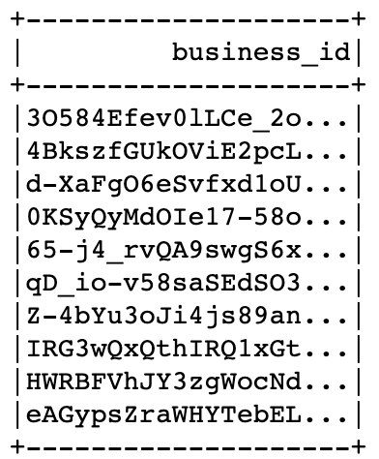
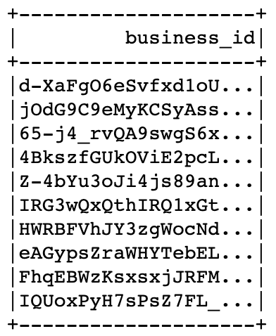
Recommend to specific user
Recommend based on classification/Regression
1. Fit the whole dataset “combineddf” with best parameters from best model (Decision Tree, Decision Tree Regression)
2. create new feature dataframe: combine feature from “multiple businesses” and feature from this “one user”
3. Transform the new feature dataframe
4. To classification model, recommend top 10 business which is in category “5” and order by business_average_star
5. To regression model, recommend top 10 business ordered first by predicted review_star then by business_average_star
Take user who have id “0y8ORuC2X1i1UF6SG1hlkQ” as example:
Decision Tree classification:
Decision Tree regression:

Slide 20
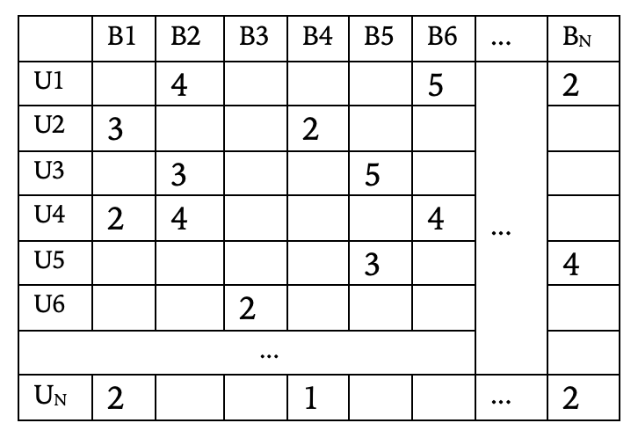
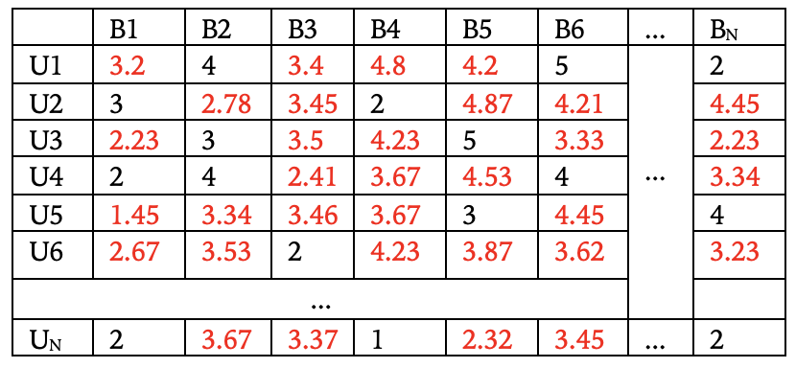
PySpark ALS
Alternating Least Squares (ALS) algorithm:
Collaborative Filtering
Model Based
Matrix Factorization: ALS
Predicted Value

Slide 21
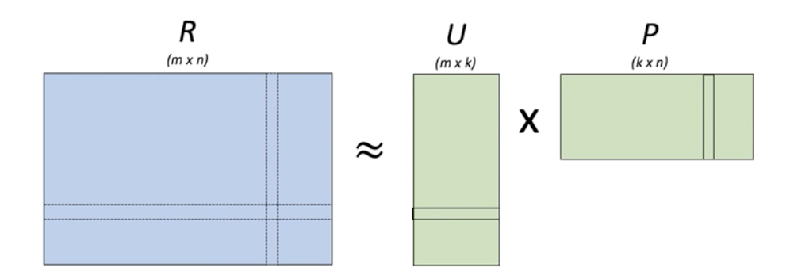
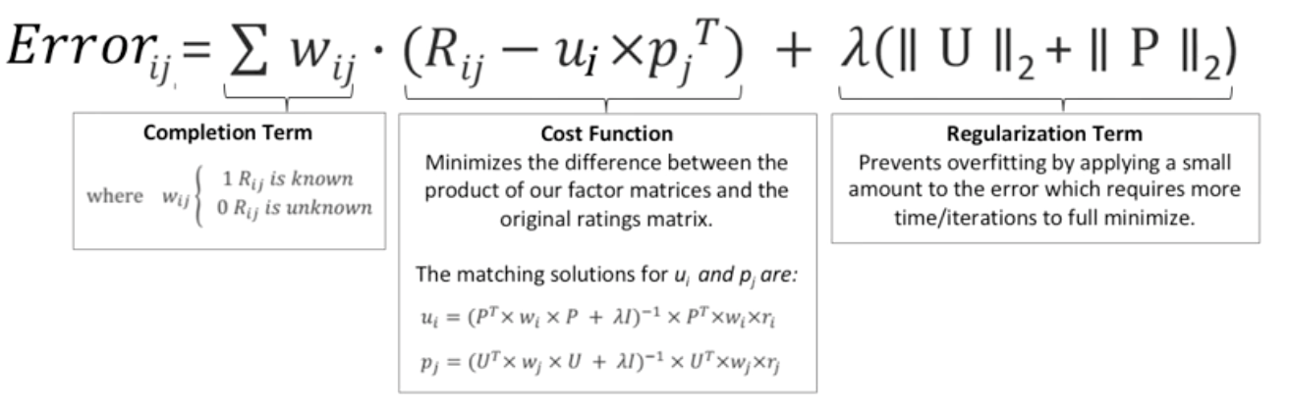
PySpark ALS
Alternating Least Squares (ALS) algorithm:
Minimize the Error!

Slide 22
PySpark ALS
PySpark ALS for Recommendation:
What is an implicit problem?
Examples:
recommend music to listener, ALS model uses Playing times;
recommend goods to user, ALS model uses Click times
No specific rating numbers/more difficult to work with
Our problem is Explicit problem:
Have 0-5 star-scale
Easier to predict but put the responsibility of data collection on the user

Slide 23
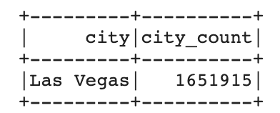
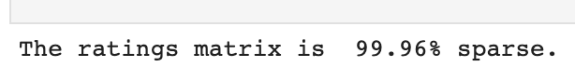
PySpark ALS
PySpark ALS Process:
Step1: Select sample
(1) Combine 3 data files to form business-user-star matrix
(2) Select down sample to reduce the sparsity of matrix to improve model performance
The steps of down-sample:
choose the business which have reviews > 30
choose the user whose giving reviews > 10
choose the city which have the most reviews (Las Vegas)
(3) Our input matrix’s Sparsity is 99.96%.

Slide 24
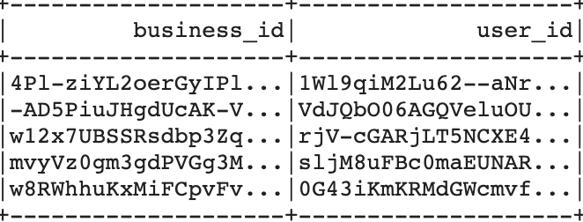
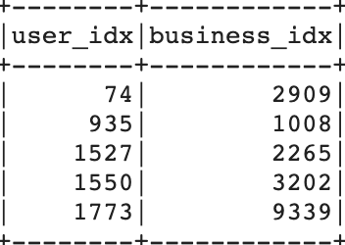
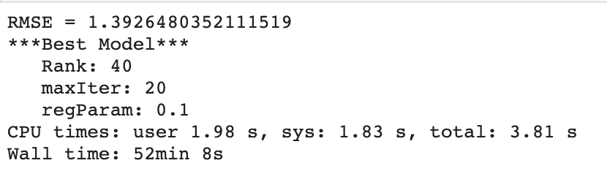
PySpark ALS
PySpark ALS Process:
Step2: Build ALS Model
(1) Split train and test data: 8:2
(2) ALS model require the id to be integer
Use window function to convert each business_id and user_id from object to one unique integer
(3) ALS model’s Parameters:
implicitPrefs=False for explicit problem
maxIter times to alternate between U and P matrix to minimize the error
regParam prevent ALS from overfitting to the data
coldStartStrategy='drop’, nonnegative = True avoid to return NAN and negative predictions
(4) Param_Grid & Cross Validation
Fine-tuning for the best performance

Slide 25
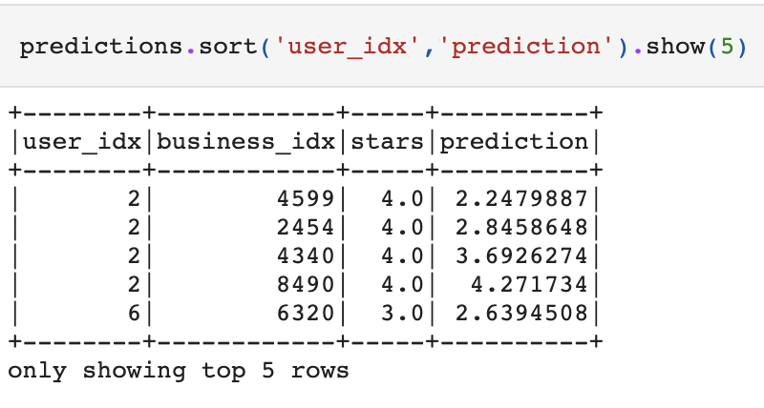
PySpark ALS
PySpark ALS Process:
Step3: Give recommendations
Apply best model on all the data at Las Vegas
Return the dataframe, meaning the matrix R’s NaN replaced by predicted ratings:

Slide 26
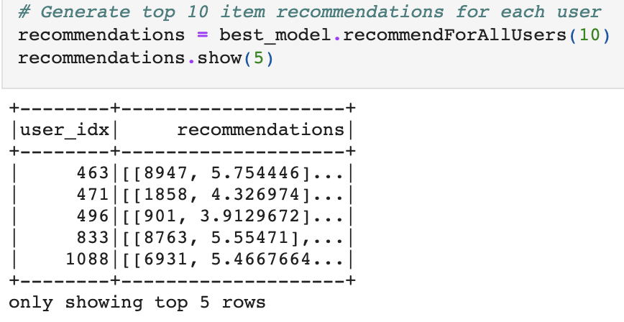
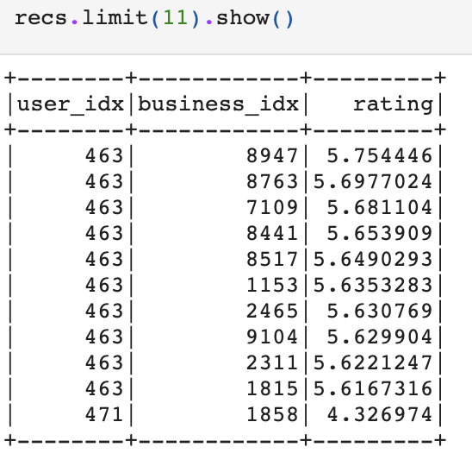
PySpark ALS
PySpark ALS Process:
Step3: Give recommendations
(2) Give each user 10 recommendations:
More readable format!

Slide 27
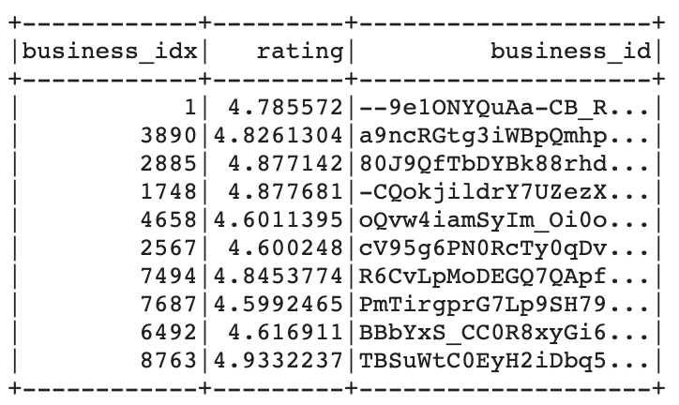
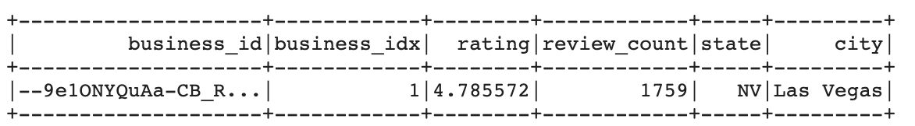
PySpark ALS
PySpark ALS Process:
Step4: Take one user_id as an example
one random user_id: 0y8ORuC2X1i1UF6SG1hlkQ

Slide 28
Limitation
Conclusion
1. As for Yelp dataset:
no very detailed and clear categories
no cover all the national regions’ information
Original data’s high sparsity >99.99%
2. As for Classification:
Features other than business average stars and user average star have low correlation with our prediction index --- review star
3. As for PySpark ALS Model:
Cannot recommend to new users before they don't give any ratings
Cannot recommend to users the similar business, only based on predicted ratings

Slide 29


Thanks for listening!
Q & A Part!

